Slide 1
Advanced Databases
- M. K. Valvi

Slide 2
Data Warehouse: ETL

Slide 3
ETL Overview
Data Warehouse environment is divided into three functional areas:
Data Acquisition,
Data Storage and
Information Delivery
Data extraction, data transformation, and data loading encompass the areas of data acquisition and data storage
ETL functions reshape the relevant data from the source systems into useful information to be stored in the data warehouse

Slide 4
ETL Overview
Back-end processes and functions that covers:
extraction of data from the source systems
Changing the source data into the exact formats and structures appropriate for storage in DW
Physically moving the data into the DW repository
Data extraction : Scope and Extent?
Data extraction presupposes a selection process
The extent and complexity of the back-end processes differ from one data warehouse to another
Notes:
Some data ware houses that are intereste in some date need date standardization which can be escaped if date is not needed by any DW

Slide 5
ETL Overview
Each of the ETL function is important and essential. Each function fulfils a significant purpose
All of the functions must be performed in sequence for successfully transforming data into strategic information or business intelligence
ETL functions are challenging primarily because of the nature of the source systems
ETL processes are Time Consuming and Arduous

Slide 6
List of reasons for the types of difficulties in ETL functions
Source systems are very diverse and disparate
Need to deal with source systems on multiple platforms and different operating systems
older legacy applications running on obsolete database technologies
Historical data on changes in values are not preserved
Quality of data is dubious in many old source systems
Source system structures keep changing over time
Gross lack of consistency among source systems is prevalent
Lack of means for resolving mismatches escalates the problem of inconsistency
Most source systems do not represent data in types or formats that are meaningful to the users

Slide 7
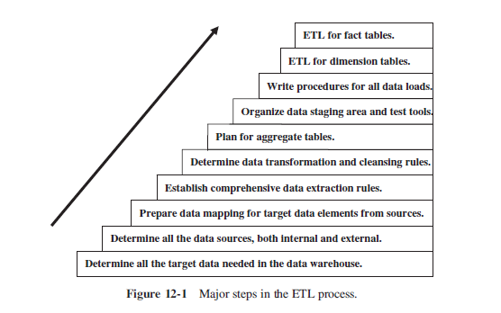
ETL Steps

Slide 8
Data Extraction
Factors increasing complexity of Data Extraction
First, for a data warehouse, you have to extract data from many disparate sources
Second, for a data warehouse, you have to extract data on the changes for ongoing incremental loads as well as for a one-time initial full load
Use of third-party data extraction tools in addition to in-house programs or scripts is recommended

Slide 9
Data Extraction
Data Extraction issues
Source identification
Identify source applications and source structures
Method of extraction
for each data source, define whether the extraction process is
manual or tool-based
Extraction frequency
for each data source, establish how frequently the data extraction must be done: daily, weekly, quarterly, and so on
Time window
for each data source, denote the time window for the extraction process

Slide 10
Data Extraction
Data Extraction issues
Job sequencing
determine whether the beginning of one job in an extraction job stream has to wait until the previous job has finished successfully
Exception handling
determine how to handle input records that cannot be extracted
Notes:
Incomplete order cannot store customer data

Slide 11
Identification of Data Sources
Nature of the source data and its intended use must be understood
Business transactions keep changing the data in the source systems
Data in the source systems are said to be time-dependent or temporal, value of a single variable varies over time
Every change is the source system must be identified by data Warehouse (Capturing the history)
Can be done by knowing how source systems store the data

Slide 12
Identification of Data Sources

Slide 13
Data in Operational Sources
Current Value
The stored value of an attribute represents the value of the attribute at this moment of time
Transient/Transitory values, changes with business transaction
Change in value cannot be predicted
Data extraction for preserving the history of the changes in the data warehouse gets quite involved for this category of data
Most of the attributes in the source systems fall into this category
E.g. Customer name and address, bank account balances, and outstanding amounts on individual orders etc.

Slide 14
Data in Operational Sources
Periodic Status
Not as common as Current Value
The value of the attribute is preserved as the status every time a change occurs
The status value is stored with reference to the time when the new value became effective
For operational data in this category, the history of the changes is preserved in the source systems themselves
Whether it is status data or data about an event, the source systems contain data at each point in time when any change occurred
E.g. Data about an Insurance policy, bonus accumulated over time

Slide 15
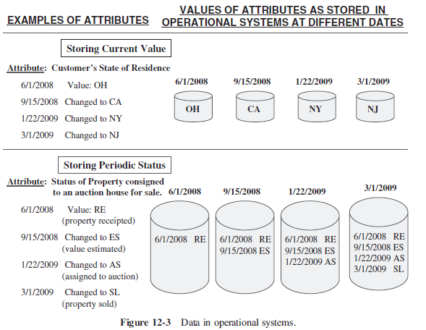
Data in Operational Sources

Slide 16
Types of Data Extractions
“as is” (static) Data
Capture of data at a given point in time
Static data capture is primarily used for the initial load of the data warehouse
Data of revisions
also known as incremental data capture
Strictly not incremental but revisions since last data capture
Difficult if source of data is transient
Incremental data capture may be immediate or deferred
Notes:
Rate of interest for bank loan( data revisions eg)

Slide 17
Immediate Data Extraction
Data extraction is real time
It occurs as the transactions happen at the source databases and files
Three options of immediate extractions
Capture through transaction logs
Capture through database triggers
Capture in source applications

Slide 18
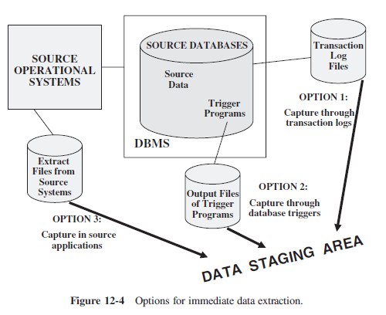
Immediate Data Extraction

Slide 19
Immediate Data Extraction
Capture through transaction logs
Uses the transaction logs of the DBMSs maintained for recovery from possible failures
This data extraction technique reads the transaction log and selects all the committed transactions
No extra overhead in the operational systems because logging is already part of the transaction processing
All log transactions must be extracted for DW
This option won’t work if source system data is on indexed and other flat files as no log files for non-database applications

Slide 20
Immediate Data Extraction
Capture through Database Triggers
This option is also applicable to the source systems that are database applications
Trigger programs can be created for all events for which data needs to be captured
The output of the trigger programs is written to a separate file that will be used to extract data for the data warehouse
Data capture through database triggers occurs right at the source and is therefore quite reliable
Additional burden of building and maintaining triggers and execution of it during transaction processing

Slide 21
Immediate Data Extraction
Capture in Source Applications
Also referred to as application assisted data capture
The source application is made to assist in the data capture for the data warehouse
Relevant application programs needs to be modified that write to source files and databases
This technique may be used for all types of source data irrespective of whether it is in databases, indexed files, or other flat files
Programs in the source operational systems needs to be revised and keep them maintained
Difficult if number of source system program is large, also may degrade the performance of source applications

Slide 22
Deferred Data Extraction
Data extraction is not real time
Two options of deferred extractions
Capture Based on Date and Time Stamp
Capture by Comparing Files

Slide 23
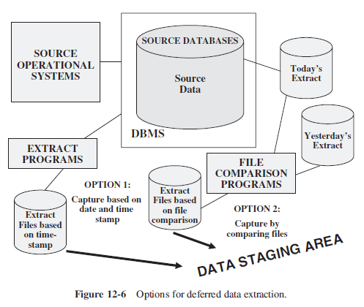
Deferred Data Extraction

Slide 24
Deferred Data Extraction
Capture Based on Date and Time Stamp
Every time a source record is created or updated it may be marked with a stamp showing the date and time. The time stamp provides the basis for selecting records for data extraction
This technique works well if the number of revised records is small
This technique presupposes that all the relevant source records contain date and time stamps
Works for any type of source file, given date and time stamps are recorded
Captures the latest state of the source data. Any intermediary states between two data extraction runs are lost

Slide 25
Deferred Data Extraction
Capture Based on Date and Time Stamp
Extra logic needs to be added for certain cases like deletion of source record
Capture by comparing Files
Last resort, if none of the techniques mentioned previously work for any of the source files
Also called the snapshot differential technique because it compares two snapshots of the source data
Full file comparison is done between the two copies (Prior and Later), then changes between the two is captured
This technique necessitates the keeping of prior copies of all the relevant source data

Slide 26
Deferred Data Extraction
Capture by comparing Files
Simple and straightforward
Inefficient for large files
This may be the only feasible option for some legacy data sources that do not have transaction logs or time stamps on source records

Slide 27
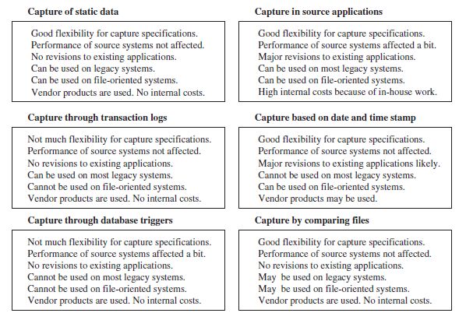
Data Extraction Techniques

Slide 28
Data Transformation

Slide 29
Basic Tasks
Selection or filtering of records
Takes place at the beginning
Either whole records or parts of several records from the source systems are selected to meet the predefined criterian
Task of selection usually forms part of the extraction function itself
In the cases where composition of the source structure may not be amenable to selection of the necessary parts during data extraction, it is prudent to extract the whole record and then do the selection as part of the transformation function
Data cleansing
Removing duplicates from a dataset.
the duplicates can skew analysis results and waste storage space. Removing them ensures data integrity and accuracy.

Slide 30
Basic Tasks
Splitting / Joining
Includes the types of data manipulation needed to perform on the selected parts of source records
Sometimes, uncommonly, splitting of the selected parts even further during data transformation is needed
Joining of parts selected from many source systems is more widespread in the data warehouse environment

Slide 31
splitting
Address 123 Main St, Springfield, IL 62701
456 Elm St, Anytown, NY 12345
Street Address | City | State | Zip Code
----------------------------------------------
123 Main St | Springfield| IL | 62701
456 Elm St | Anytown | NY | 12345
joining
Order ID | Product ID | Quantity | Total
----------------------------------------
101 | P001 | 2 | $100
102 | P002 | 1 | $50
Product ID | Product Name | Category | Price --------------------------------------------
P001 | Laptop | Electronics | $500
P002 | Smartphone | Electronics | $400
rder ID | Product ID | Quantity | Total | Product Name | Category | Price
--------------------------------------------------------------------------------
101 | P001 | 2 | $100 | Laptop | Electronics | $500
102 | P002 | 1 | $50 | Smartphone | Electronics | $400

Slide 32
Basic Tasks
Conversion( eg. Name of person, date etc.)
An all-inclusive task
Includes a large variety of rudimentary conversions of single fields for two primary reasons
to standardize among the data extractions from disparate source systems, and
to make the fields usable and understandable to the users
Country
-------------------
United States
USA
U.S.
United Kingdom
UK
United Kingd
Standardized Country
-------------------
United States
United States
United States
United Kingdom
United Kingdom
United Kingdom
Converting units of measurement (e.g., converting pounds to kilograms) for consistency and comparability.

Slide 33
Basic Tasks
Summarization
Sometimes it is not feasible to store the data at the lowest level of detail in DW, for such cases summarization is used
Maybe none of the users ever need the data at the lowest granularity for analysis or querying
For example, for a grocery chain, sales data at the lowest level of detail for every transaction at the checkout may not be needed, storing sales by product by store by day in the data warehouse is sufficient
Calculating total sales by summing up individual sales transactions.
such aggregation of data allows for the analysis of trends and patterns at a higher level of granularity.

Slide 34
Basic Tasks
Enrichment
This task is the rearrangement and simplification of individual fields to make them more useful for the data warehouse environment
One or more fields from the same input record can be used to create a better view of the data for the data warehouse
This principle is extended when one or more fields originate from multiple records, resulting in a single field for the data warehouse
Example: Adding geographical information (e.g., latitude and longitude) based on postal codes enhances its value for analysis and reporting purposes.

Slide 35
Major Transformation Types
Format revisions
Decoding of Fields
Calculated and Derived Values
Splitting of Single Fields
Merging of Information
Character set conversion
Conversion of Units of Measurements
Date/Time Conversion
Summarization
Key Restructuring
Deduplication.

Slide 36
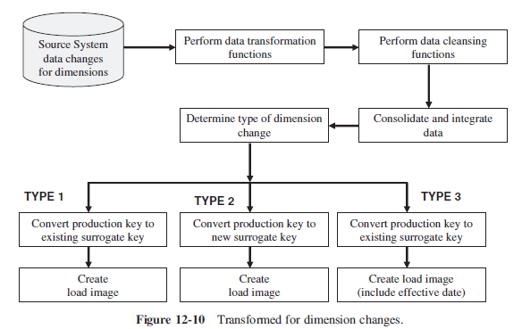
Implementing Transformation

Slide 37
Data Loading

Slide 38
Data Loading Types of applying data
Initial Load
populating all the data warehouse tables for the very first time
Incremental Load
applying ongoing changes as necessary in a periodic manner
Full Refresh
completely erasing the contents of one or more tables and reloading with fresh data
(initial load is a refresh of all the tables).

Slide 39
Data Loading
Of great concern as loading may take inordinate amount of time
Data warehouse goes offline during loads so window of time must be identified for scheduling loads without affecting the work
Whole load process can be divided into smaller chunks and few files can be populated at a time, with this
Smaller loads can run in parallel
Some parts of DW can be up and running while other part are being loaded
Its hard to estimate running times of loads, especially during initial load or a complete refresh

Slide 40
Data Loading
Specific procedure needs to be provided for the records not being successfully applied to DW
Maybe having wrong concatenated key or not corresponding to the dimension tables
Transport of load images need to be handled if staging area and DW database are not on same server
Option needs to be selected (web, FTP, Database links). Also bandwidth needed needs to be considered. Have contingency plans and data compressions.
Load utilities provided by DBMSs can be used instead of special load programs. DW size must be considered
Project team must be capable of identifying and handling challenges in loading

Slide 41
Applying Data
A file of data is created which is applied to the product dimension table in the data warehouse
Data maybe applied in four modes
Load
Append
Destructive Merge
Constructive Merge

Slide 42
Modes of Applying Data
Load
If target table already exists with some data, the data is wiped out and data from incoming file is applied
If target table is empty, load process will simply apply the data from the incoming file
Append
Can be seen as an extension of Load
If target table already exists with some data, the append process unconditionally adds the data from incoming file, existing data is preserved

Slide 43
Modes of Applying Data
Append
If incoming record is duplicate of existing record, it can be handled as
Incoming record is added as duplicate
Incoming duplicate record is rejected during append process
Destructive Merge
Incoming data is applied to the target data
If primary key of an incoming record matches with the key of an existing record, matching target record is updated
If incoming record is a new record, it is added to the target table

Slide 44
Modes of Applying Data
Constructive Merge
If primary key of an incoming record matches with the key of an existing record, existing record is kept as it is and new record is added as superseding the old record

Slide 45
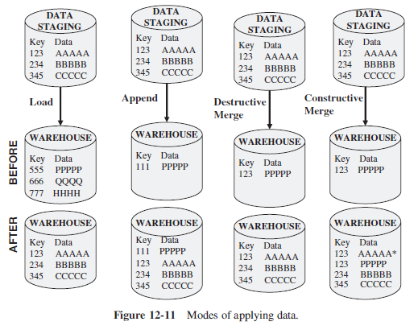
Modes of Applying Data

Slide 46
Modes of Applying Data to Types of Loads
Initial Load
In case of single load OR multiple sub-loads where every load run is creating database tables from scratch : Load mode can be used
In case, more than one runs are needed for creating single table and run is scheduled to run on several days
For the first run of the initial load uses Load mode
All further loads can apply the data using Append mode
Index creation for mass loads is time consuming. Indexes can be rebuilt or regenerated when the loads are complete

Slide 47
Modes of Applying Data to Types of Loads
Incremental Load
For such type of loads, a method is needed to preserve the periodic nature of the changes in the data warehouse
Constructive merge mode is an appropriate method for incremental loads, as it preserves the periodic nature of the changes
Destructive merge can be used for Type 1 changes in dimensions
The mode can also be used if historical perspective is not important

Slide 48
Modes of Applying Data to Types of Loads
Full Refresh
Entire data warehouse or partial refresh to specific table is done. However partial refreshes are rare as every dimension table is intricately tied to the fact table
Similar to initial load, except data exists in target tables
Load mode or Append mode are applicable

Slide 49
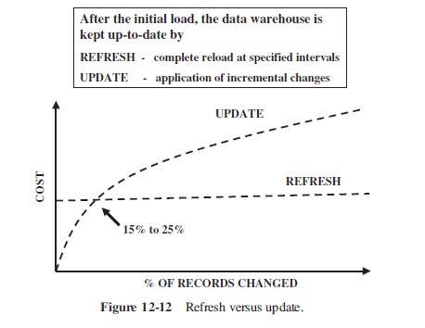
Data Refresh vs Update
After initial load, data warehouse is maintained and kept up-to-date by
Update: application of incremental changes in the data sources
Refresh: complete reload at specified intervals

Slide 50
Loading Dimension Tables
The procedure for maintaining the dimension tables includes two functions
first, the initial loading of the tables
thereafter, applying the changes on an ongoing basis
Two issues to be addressed in loading dimension tables
first one is about the keys of the records in the source systems and the keys of the records in the data warehouse
Before source data can be applied to the dimension tables, whether for the initial load or for ongoing changes, the production keys must be converted to the system-generated keys in the data warehouse.

Slide 51
Loading Dimension Tables
Two issues to be addressed in loading dimension tables
first one is about the keys of the records in the source systems and the keys of the records in the data warehouse
Key conversion can be a part of transformation function or separate key translation can be used
Later is preferable
Another issue relates to the application of the type 1, type 2, and type 3 dimension changes to the data warehouse

Slide 52
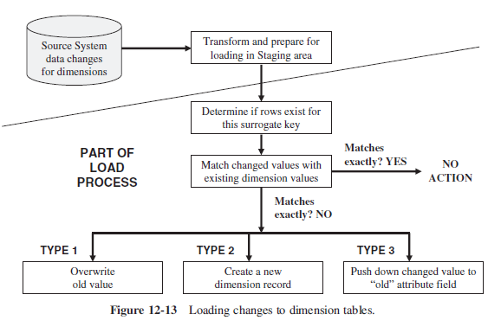
Loading Dimension Tables

Slide 53
Loading Fact Tables
The key of the fact table is the concatenation of the keys of the dimension tables
So, dimension records are loaded first and then before loading fact table, concatenated key needs to be created from the keys of corresponding dimension tables
thereafter, applying the changes on an ongoing basis
Fact table loads can be of two types
History Loads
Incremental Loads

Slide 54
Fact Tables History Loads
Tips for history loads of the fact tables
Identify historical data useful and interesting for the data warehouse
Define and refine extract business rules
Capture audit statistics to tie back to the operational systems
Perform fact table surrogate key look-up
Improve fact table content
Restructure the data
Prepare the load files

Slide 55
Fact Tables Incremental Loads
Useful remarks about incremental loads for Fact Tables
Incremental extracts for fact tables
Consist of new transactions
Consist of update transactions
Use database transaction logs for data capture
Incremental loads for fact tables
Load as frequently as feasible
Use partitioned files and indexes
Apply parallel processing techniques

Slide 56
References
Paulraj Ponniah, “Data Warehousing Fundamentals For It Professionals”, Second Edition, Wiley Publication, 2010

